Slide 1
INVESTMENT CASE STUDY SUBMISSION
Group Name:
Member name
Member name
Member name
Member name

Slide 2
<Abstract>
1

Slide 3
<Problem solving methodology>
2
Use flow chart

Slide 4
<Analysis>
3 Funding Type Analysis

Slide 5
<Analysis>
4 Country Analysis

Slide 6
<Analysis>
5. Sector Analysis

Slide 7
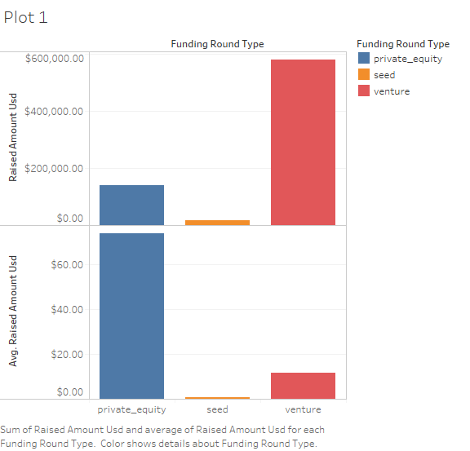
<Funding type (FT) is best suited for Spark Funds>
Plot 1

Slide 8
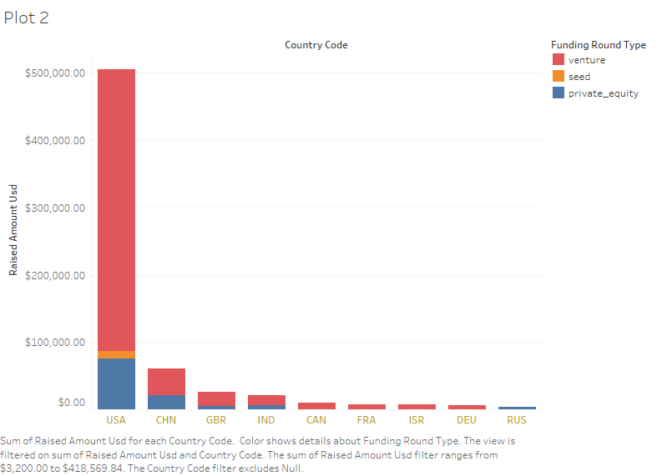
<Top 9 countries against the total amount of investments of funding type FT>
Plot 2

Slide 9
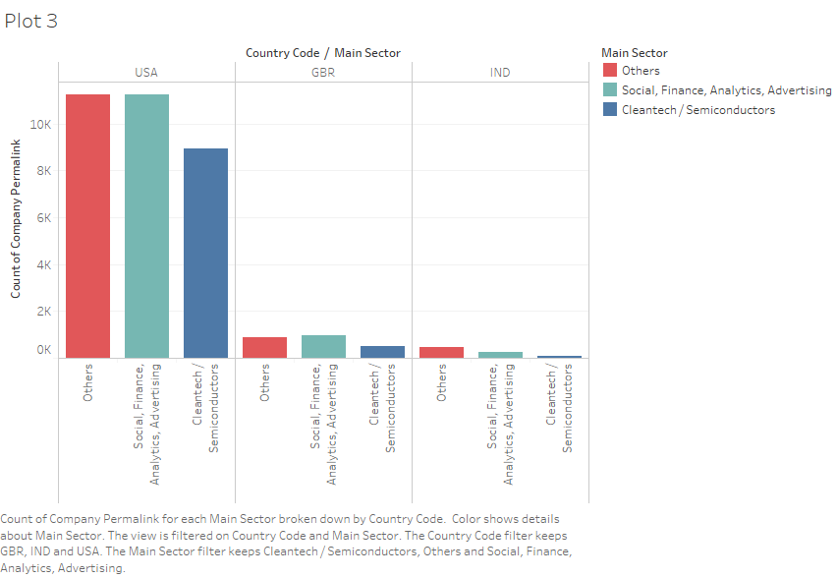
<Number of investments in the top 3 sectors of the top 3 countries >
Plot 3

Slide 10
<Conclusions>

